Slide 1
2020-1-RO01-KA226-095728
PRIMEIROS
SOCORROS APLICADOS A CRIANÇAS
____
ENTORSE

Slide 2
2020-1-RO01-KA226-095728
PRIMEIROS
SOCORROS APLICADOS A CRIANÇAS
____
ENTORSE
DEFINIÇÃO DE ENTORSE

Slide 3
2020-1-RO01-KA226-095728
PRIMEIROS
SOCORROS APLICADOS A CRIANÇAS
____
ENTORSE
MATERIAIS PARA
TRATAMENTO
DE UMA ENTORSE

Slide 4
2020-1-RO01-KA226-095728
PRIMEIROS
SOCORROS APLICADOS A CRIANÇAS
____
ENTORSE
PROCEDIMENTO PARA TRATAMENTO
DE UMA ENTORSE

Slide 5
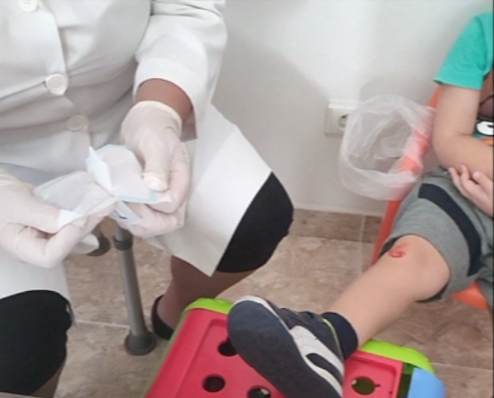
2020-1-RO01-KA226-095728
PRIMEIROS
SOCORROS APLICADOS A CRIANÇAS
____
HEMORRAGIA EXTERNA

Slide 6
2020-1-RO01-KA226-095728
PRIMEIROS
SOCORROS APLICADOS A CRIANÇAS
____
HEMORRAGIA EXTERNA
DEFINIÇÃO DE
HEMORRAGIA EXTERNA

Slide 7
2020-1-RO01-KA226-095728
PRIMEIROS
SOCORROS APLICADOS A CRIANÇAS
____
HEMORRAGIA EXTERNA
MATERIAIS PARA
TRATAMENTO DE UMA
HEMORRAGIA EXTERNA

Slide 8
2020-1-RO01-KA226-095728
PRIMEIROS
SOCORROS APLICADOS A CRIANÇAS
____
HEMORRAGIA EXTERNA
PROCEDIMENTO PARA TRATAMENTO DE UMA
HEMORRAGIA EXTERNA

Slide 9
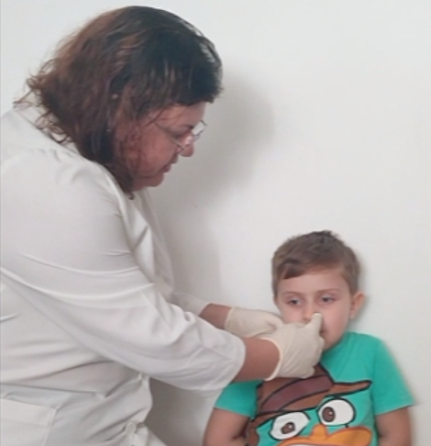
2020-1-RO01-KA226-095728
PRIMEIROS
SOCORROS APLICADOS A CRIANÇAS
____
HEMORRAGIA NASAL

Slide 10
2020-1-RO01-KA226-095728
PRIMEIROS
SOCORROS APLICADOS A CRIANÇAS
____
HEMORRAGIA NASAL
DEFINIÇÃO DE HEMORRAGIA NASAL (EPISTAXIS)

Slide 11
2020-1-RO01-KA226-095728
PRIMEIROS
SOCORROS APLICADOS A CRIANÇAS
____
HEMORRAGIA NASAL
MATERIAIS PARA
TRATAMENTO DE UMA HEMORRAGIA NASAL
(EPISTAXIS)

Slide 12
2020-1-RO01-KA226-095728
PRIMEIROS
SOCORROS APLICADOS A CRIANÇAS
____
HEMORRAGIA NASAL
PROCEDIMENTO PARA TRATAMENTO DE UMA
HEMORRAGIA NASAL
(EPISTAXIS)

Slide 13
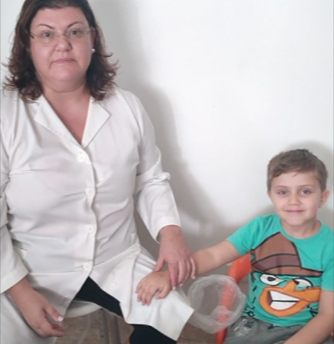
2020-1-RO01-KA226-095728
PRIMEIROS
SOCORROS APLICADOS A CRIANÇAS
____
MORDEDURA

Slide 14
2020-1-RO01-KA226-095728
PRIMEIROS
SOCORROS APLICADOS A CRIANÇAS
____
MORDEDURA
DEFINIÇÃO DE MORDEDURA

Slide 15
2020-1-RO01-KA226-095728
PRIMEIROS
SOCORROS APLICADOS A CRIANÇAS
____
MORDEDURA
MATERIAIS PARA
TRATAMENTO DE UMA MORDEDURA

Slide 16
2020-1-RO01-KA226-095728
PRIMEIROS
SOCORROS APLICADOS A CRIANÇAS
____
MORDEDURA
PROCEDIMENTO PARA TRATAMENTO DE UMA MORDEDURA

Slide 17
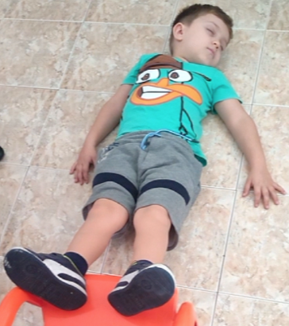
2020-1-RO01-KA226-095728
PRIMEIROS
SOCORROS APLICADOS A CRIANÇAS
____
DESMAIO

Slide 18
2020-1-RO01-KA226-095728
PRIMEIROS
SOCORROS APLICADOS A CRIANÇAS
____
ASFIXIA
DEFINIÇÃO DE ASFIXIA

Slide 19
2020-1-RO01-KA226-095728
PRIMEIROS
SOCORROS APLICADOS A CRIANÇAS
____
DESMAIO
MATERIAIS PARA
TRATAMENTO DE UM
DESMAIO

Slide 20
2020-1-RO01-KA226-095728
PRIMEIROS
SOCORROS APLICADOS A CRIANÇAS
____
ASFIXIA
PROCEDIMENTO PARA TRATAMENTO DE UMA
ASFIXIA

Slide 21
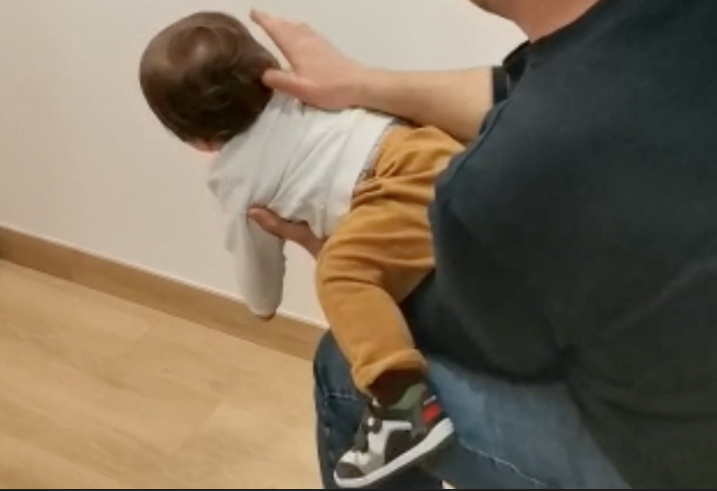
2020-1-RO01-KA226-095728
PRIMEIROS
SOCORROS APLICADOS A CRIANÇAS
____
ASFIXIA

Slide 22
ENTORSE

Slide 23
Videos about first aid applied to children
Ana Torres, Bento Cavadas, Maurício Dias, Marta Rosa

Slide 24
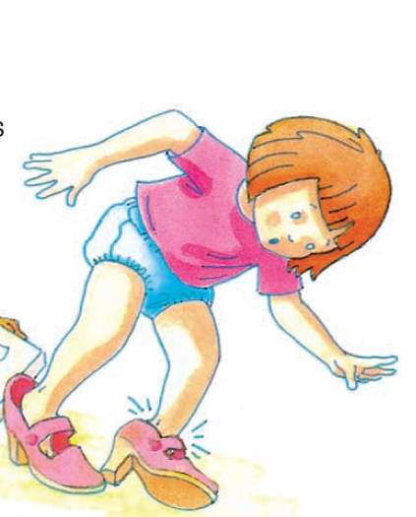
Sprain
What is a sprain?
A sprain is an injury to the soft tissue (joint capsule and/or ligaments) of a joint.

Slide 25
Sprain
What should I do?
Avoid moving the injured joint and immobilize the limb.
Elevate the injured limb.
Apply ice or cold water to the joint.
Consult a doctor afterwards.

Slide 26
Sprain
Which materials should I use?
Bandages
Ice

Slide 27
Sprain

Slide 28
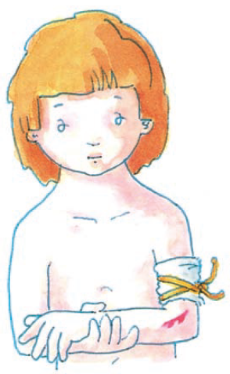
External bleeding
What is an external bleeding?
External bleeding is the outflow of blood from the body due to ruptured blood vessels.

Slide 29
External bleeding
What should I do?
Lay the victim horizontally.
Apply a sterile compress to the wound or, failing that, a clean cloth, applying firm pressure, depending on the location and extent of the wound.
If the compresses become saturated with blood, put other compresses on top, without ever removing the first ones.
Keep compressing until the bleeding stops (at least 10 minutes).
If the bleeding stops, apply a compressive dressing over the wound.

Slide 30
External bleeding
Which materials should I use?
Bandages
Band-aid
Disinfecting

Slide 31
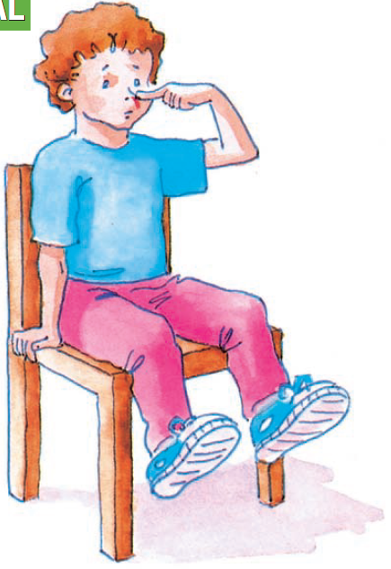
Nosebleed
What is a nosebleed?
Nosebleed is caused by ruptured blood vessels in the mucosa of the nose.

Slide 32
Nosebleed
What should I do?
Sit the victim with the head straight in body alignment (neither backward not forward).
Compress the bleeding nostril with your finger for 10 minutes.
Apply ice externally, not directly to the skin.
If the bleeding does not stop, insert a coagulating tampon into the bleeding nostril ("Spongostan" for example),by applying slight pressure so that the nasal cavity is well filled.

Slide 33
Nosebleed
Which materials should I use?
Spongostan

Slide 34
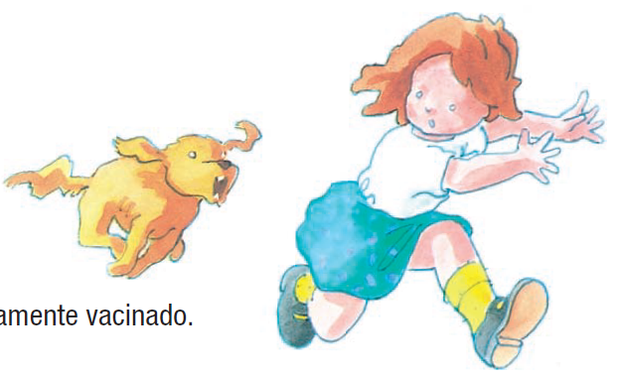
Bites
What is a bite?
A bite is an injury to the body caused by an animal's mouth (including a human).

Slide 35
Bite
What should I do?
Disinfect the bite zone.
If the bite was caused by a dog, always transport the victim to the hospital.

Slide 36
Bite
Which materials should I use?
Disinfecting

Slide 37
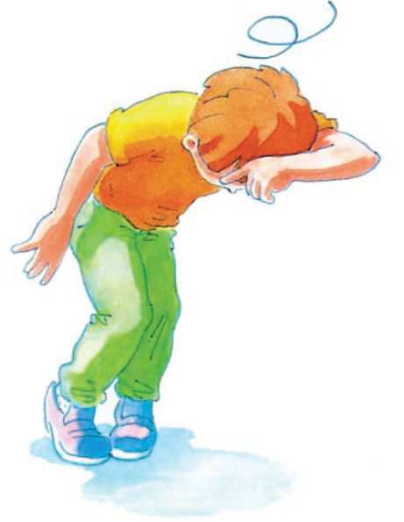
Faint
What is a faint?
A fainting is a loss of consciousness that causes the body to fall the body, caused by a lack of oxygen to the brain, to which the in the brain, to which the body reacts to which the body reacts in an automatic way.
Normally, the fainting lasts 2 to 3 minutes.
It has several causes: excess heat, fatigue, prolonged fasting, standing for a long time, etc.

Slide 38
Faint
What should I do?
If the person is going to faint:
Sit her down.
Place her head between their legs.
Splash her forehead with cold water.
Give her sugary tea or coffee.

Slide 39
Faint
What should I do?
If the person has already fainted:
Lay her down with her head on the side and legs elevated.
Loosen her clothes.
Keep her comfortably warm, but, whenever possible, in a ventilated place.
As soon as she regains consciousness, give her a sugary drink.
Consult a doctor afterwards.

Slide 40
Faint
Which materials should I use?
Sugary drink

Slide 41
References
Reis, I. (2010). Manual de Primeiros Socorros. Situações de Urgência nas Escolas, Jardins de Infância e Campos de Férias. Direção-Geral de Inovação e de Desenvolvimento Curricular

